Slide 1

Gestures and Body Language
Midori
Natsuki
Nanase

Slide 2

Introduction

Slide 3

Me? I ate boiled eggs!
Where did you go on vacation?
?
What a funny guy

Slide 4
Where did you go?
Me? I ate boiled eggs!
Me? I ate boiled eggs!
Where did you go on vacation?
?
?
What a funny guy
What a funny guy
Need for Nonverbal language

Slide 5
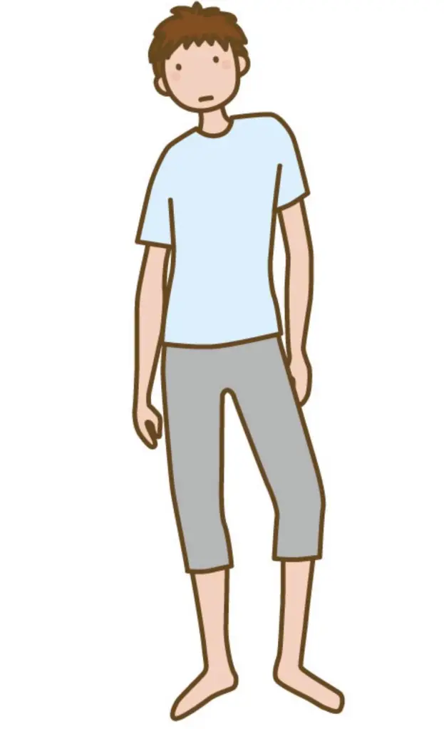


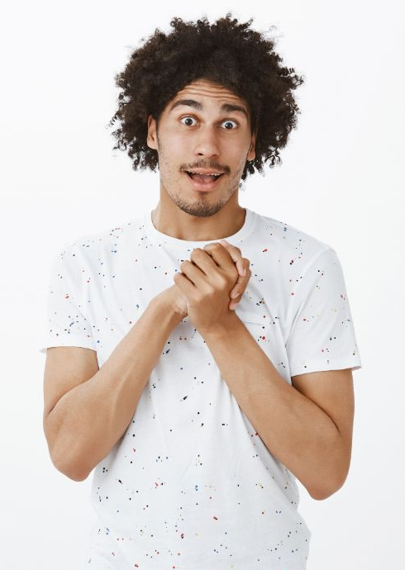
Nervous Gesture
Shifting weight
Tagging at our clothes
Wringing our hands
Adjusting our grasses

Slide 6


Planning and Practice

Slide 7

1, Descriptive gestures
Notes:
It makes our words easy to understand such as …

Slide 8
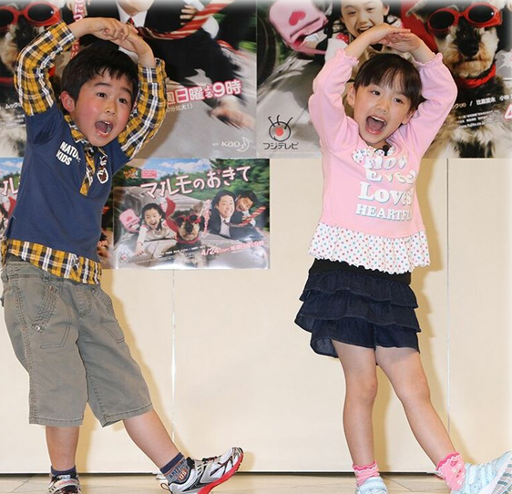
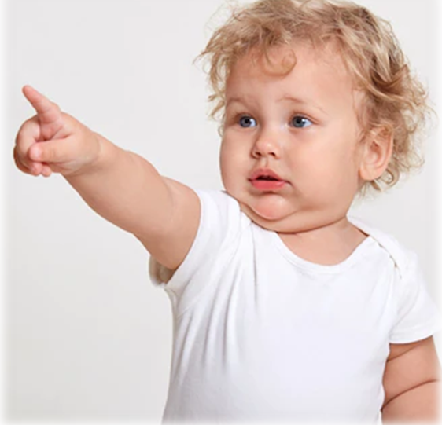

The size
The shape
The location of objects

Slide 9
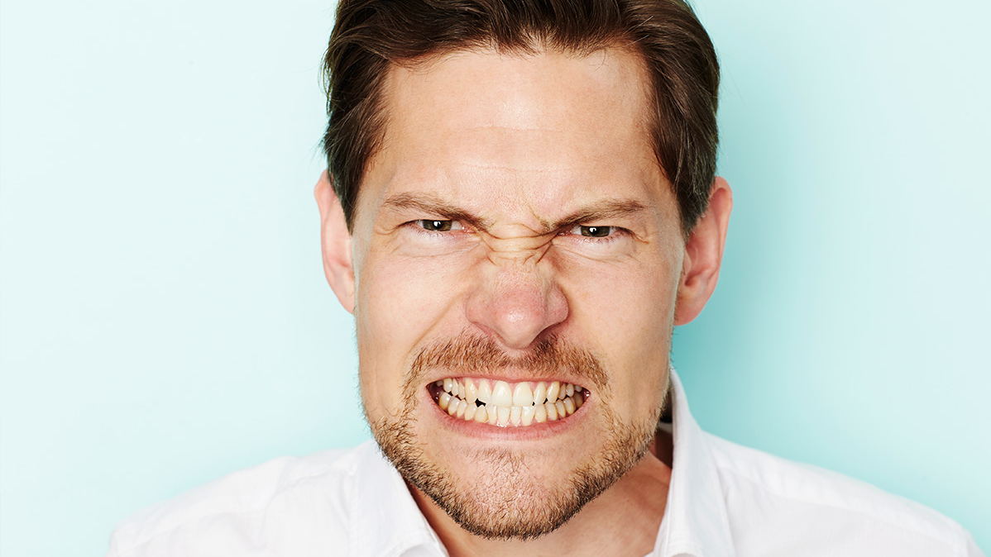
2, Emphatic gestures
Notes:
It shows our strong emotion and it helps our words more emphatically such as clenched shows frustration.

Slide 10
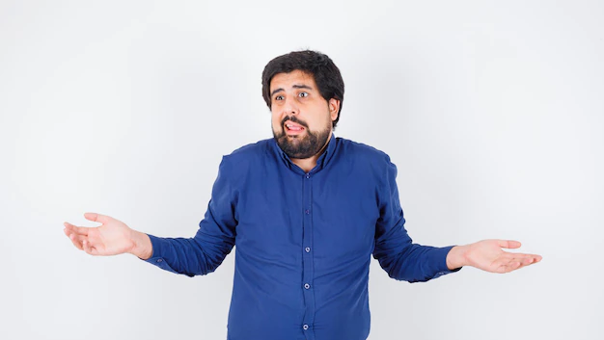
3, Suggestive gestures
Notes:
It helps us to show light emotion such as shrugging our sholders

Slide 11

4, Prompting gestures
Notes:
It helps us to get opinions from audience such as asking questions by raising your hand.

Slide 12
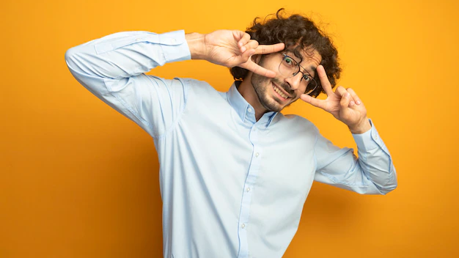
Gestures with different meaning
Notes:
When we use gestures, we have to chose gestures which suit on our speech sentence. Sometimes, gestures are offensive because they have difference meaning depend on country. For example…, so we have to know what country the audience from and concern about cultural differences carefully.

Slide 13
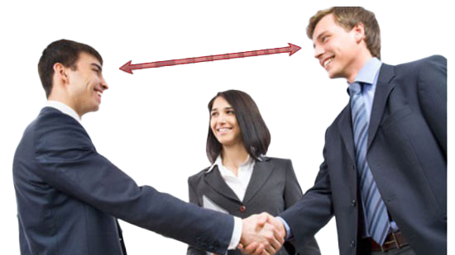
Coordinating gestures
-Be more effective
-Give more information
-Strong impact

Slide 14

Conclusion
Planning & Practice gestures
Improve & support our speech!

Slide 15


