Slide 1
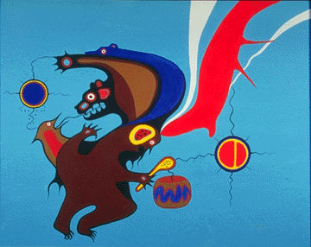
Cree
MYaki MIdori, Yuki

Slide 2
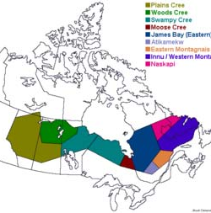
Cree
Cree are the largest group of First Nations in Canada
They live from Alberta to Newfoundedland.
356,655 people have Cree ancestry and 96,575 people speak the Cree language.( According to 2016 census data)
They call themselves Nêhiyawak.

Slide 3
Cree
There are 9 Cree communities.
Plains Cree
Woods Cree
Swampy Cree
James Bay/Eastern Cree
Moose Cree
Atikamekw
Eastern Montagnais
Innu/Western Montagnais

Slide 4
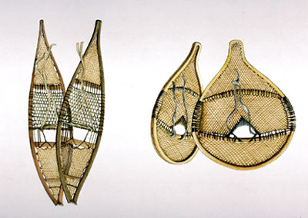
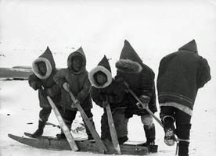
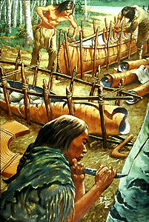
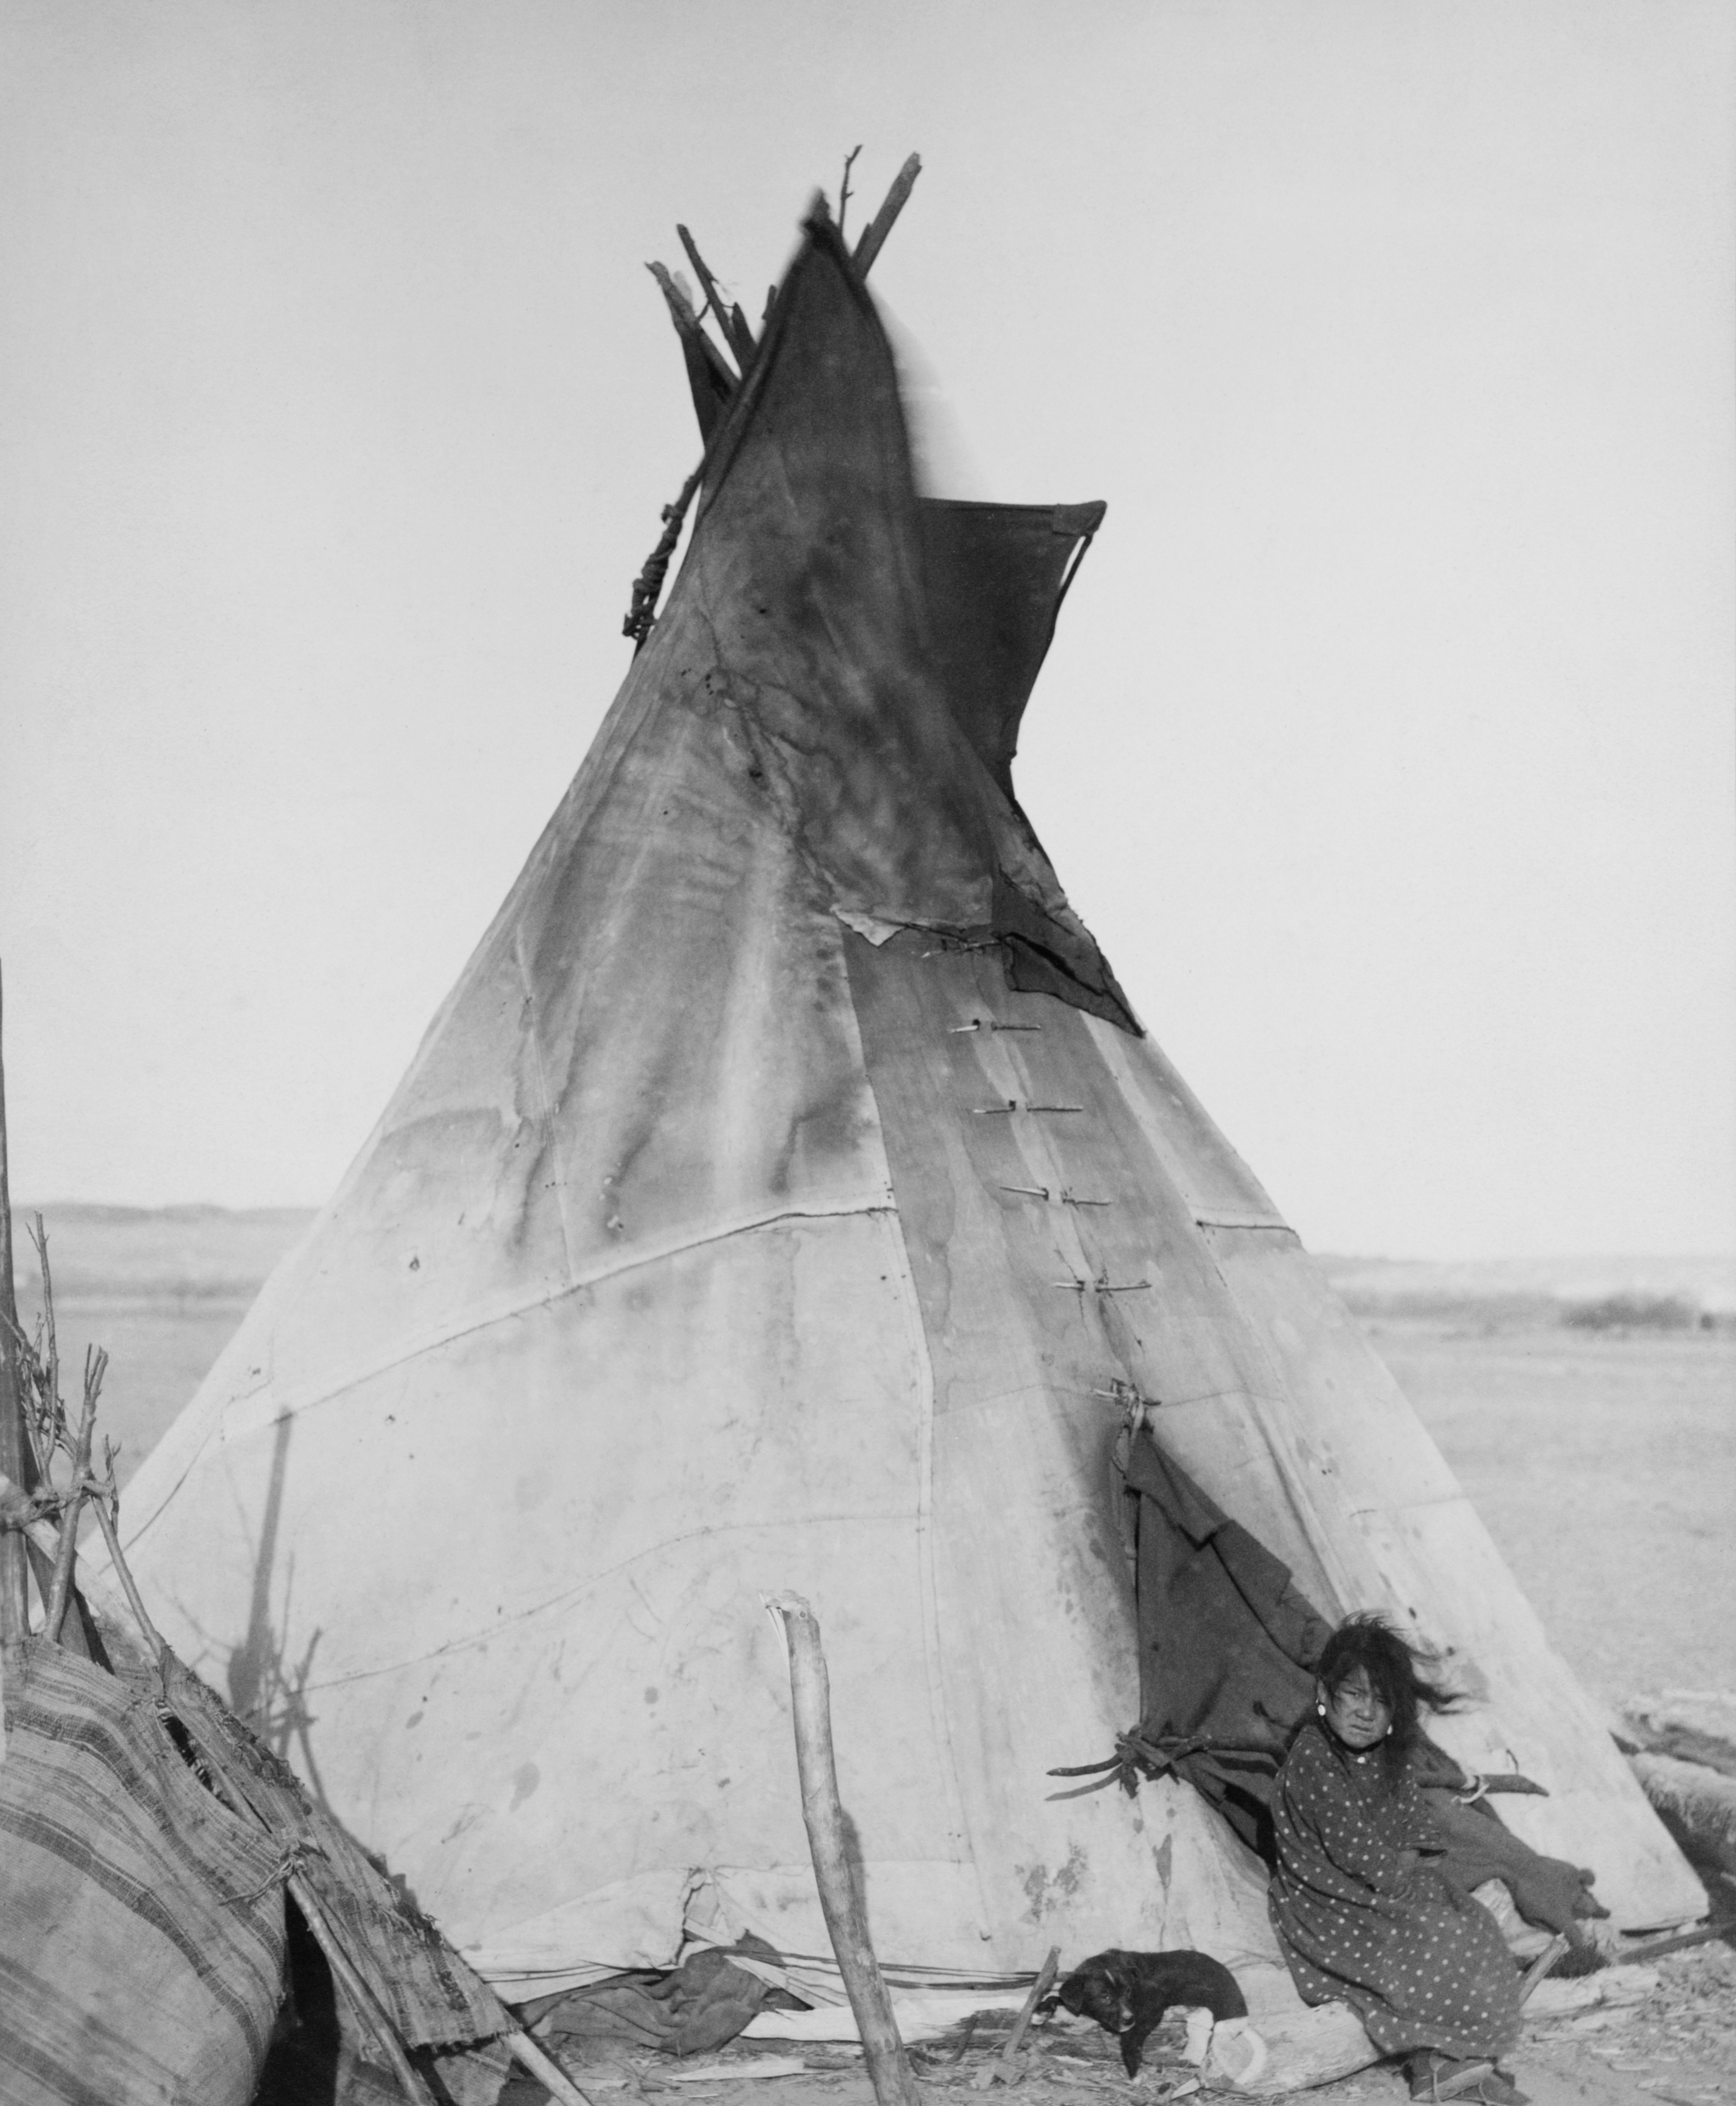
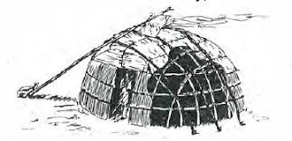
Living
The Cree followed seasonal animal migrations to obtain meat for food and animal hides and bones for the making of tools and clothing. They travelled by canoe in summer, and by snowshoes and toboggan in winter
The Woods Cree lived in lodges made from wooden poles covered with animal hides.
The Plains Cree lived in teepees made from buffalo hides and wooden poles.
Cree had a little formal government. They lived as small groups each led by a chief. The chief was respected and listened to, but did not rule over the people.

Slide 5
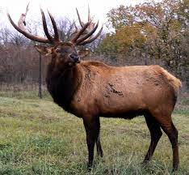
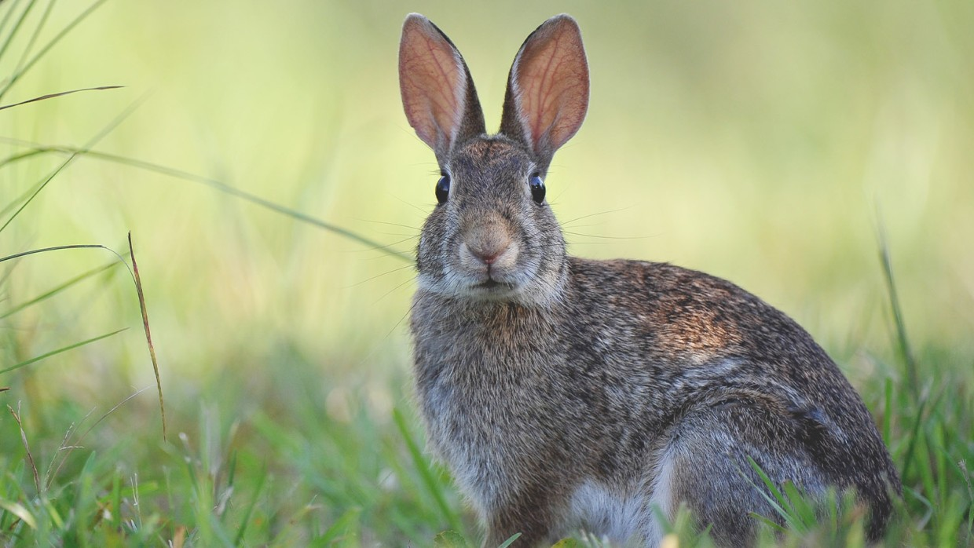

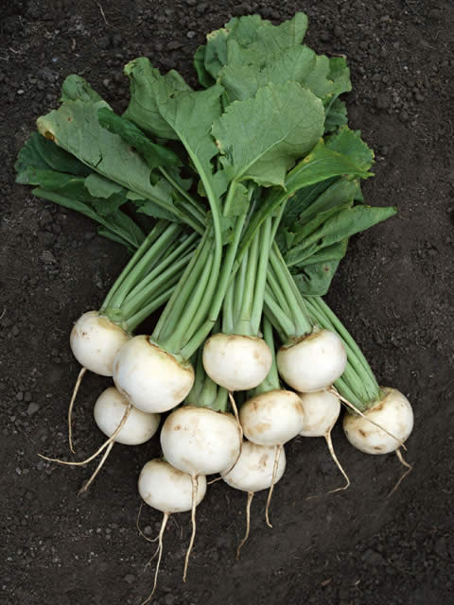
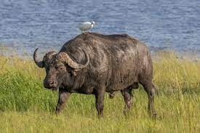
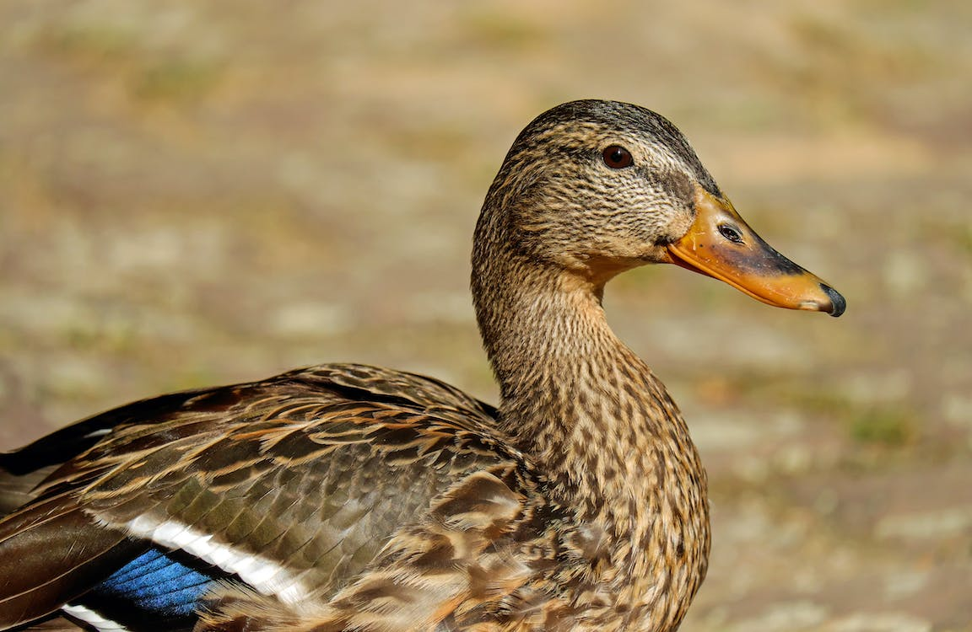

Food
The Cree were mostly hunter-gatherers.
They hunted a moose, duck, elk, buffalo, and rabbit. They also gathered food from plants such as berries, wild rice, and turnips.

Slide 6
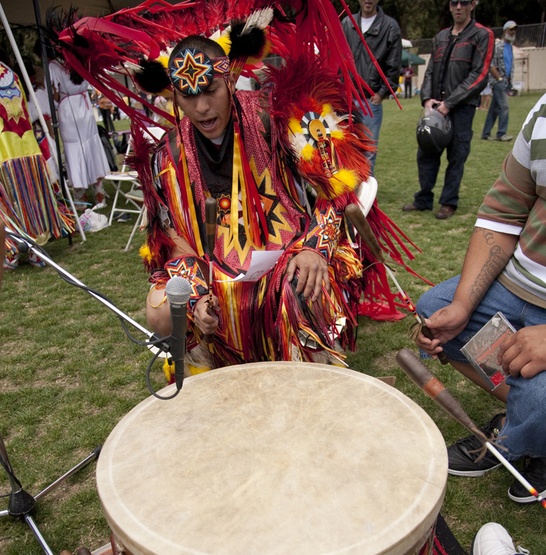

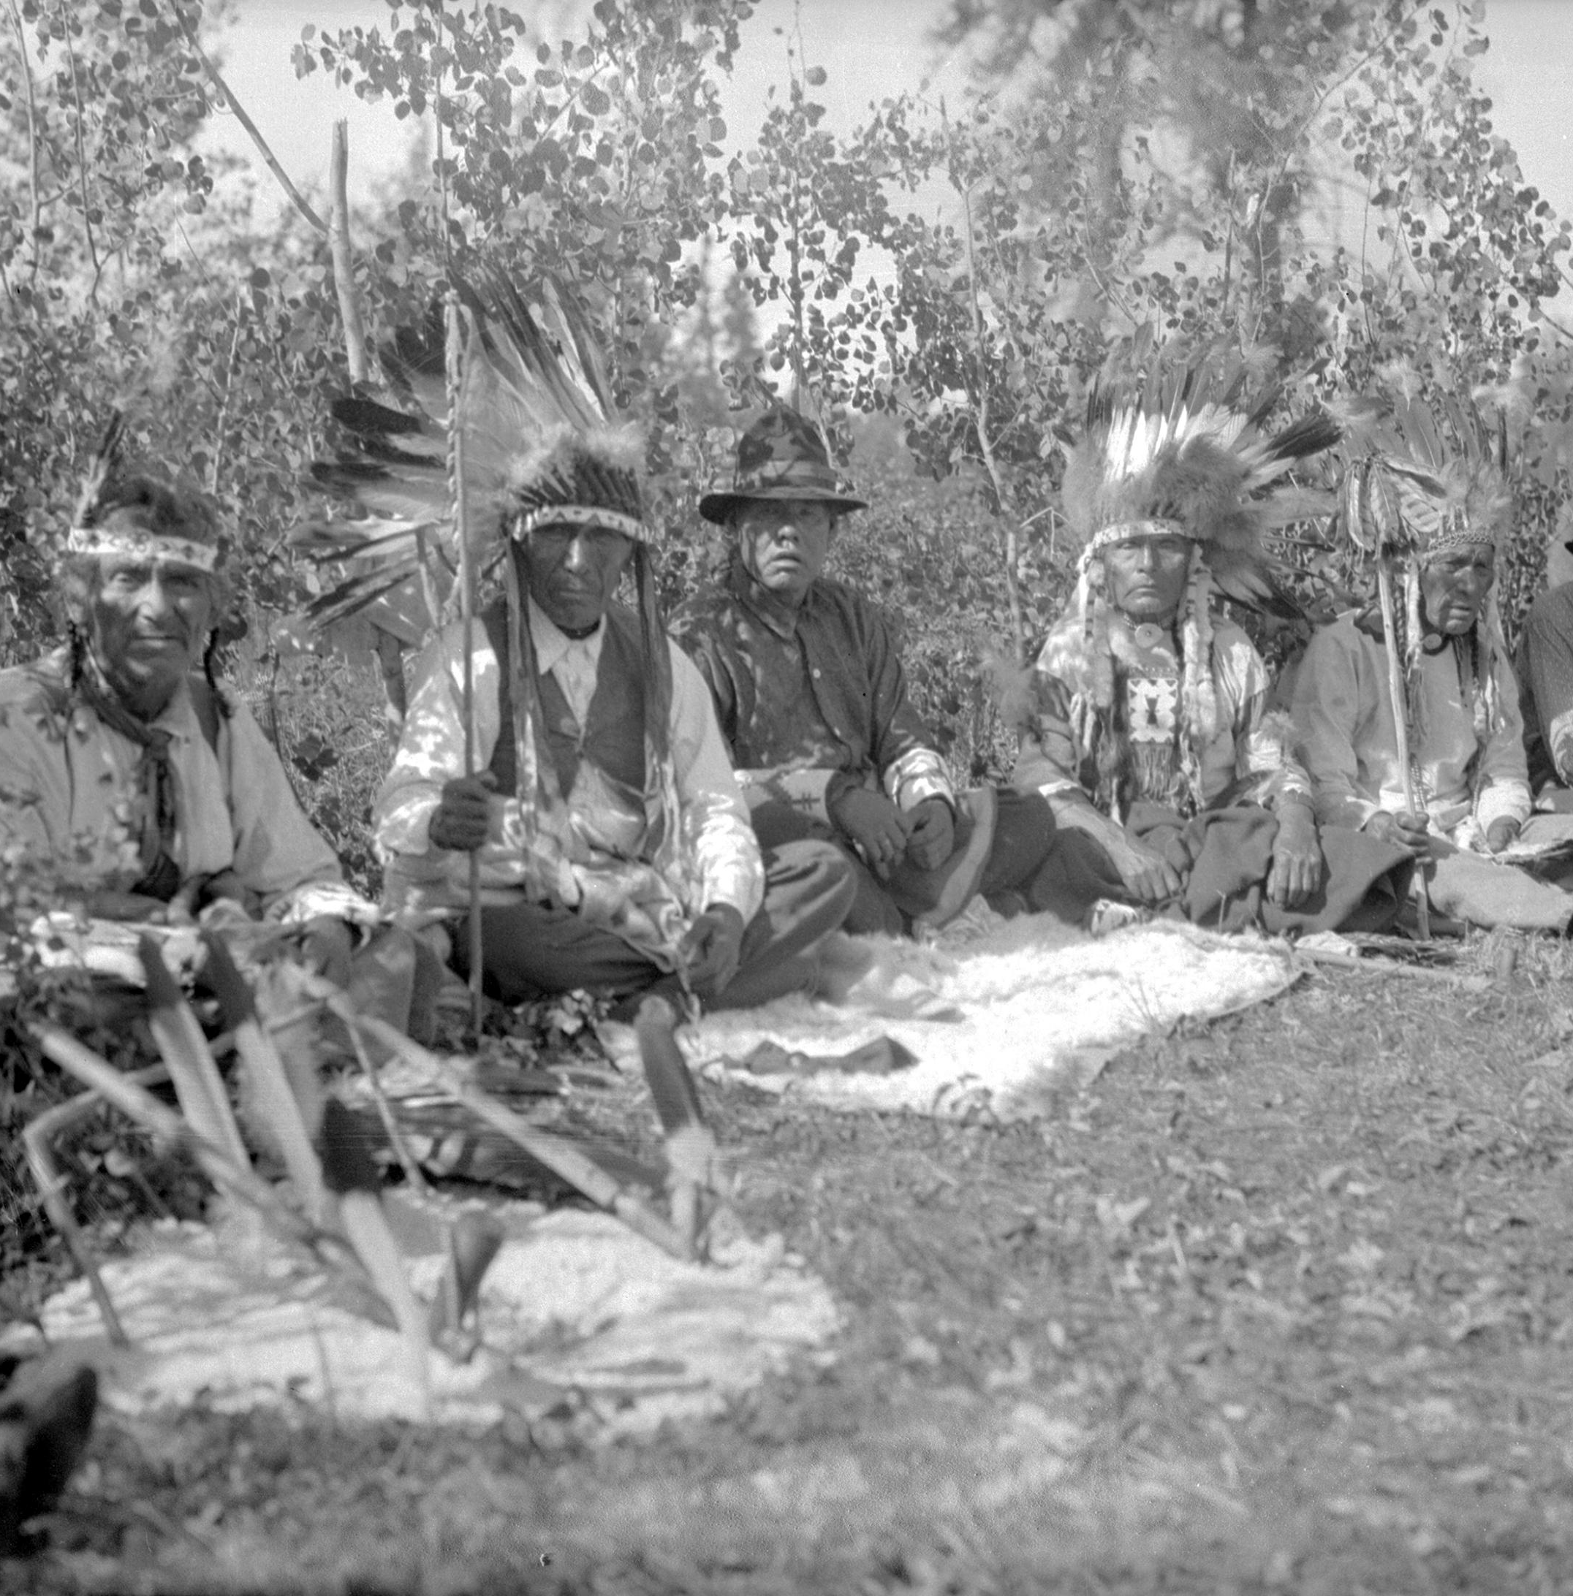
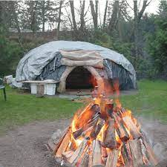
Culture
Powwows: Music and dance.
Vision quests: A test to grow up.
Pipe ceremonies: Be held before starting negotiations between different nations.
Sweat lodges: Purification rites as a way to promote healthy living.
These were banned by the Indian Act until 1951. However, the traditions survive to this day.

Slide 7
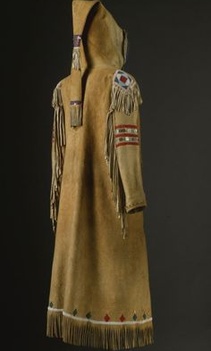
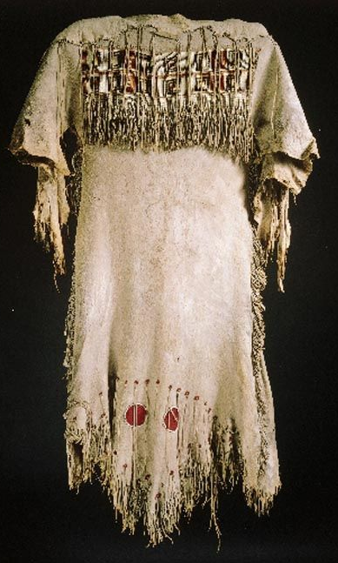
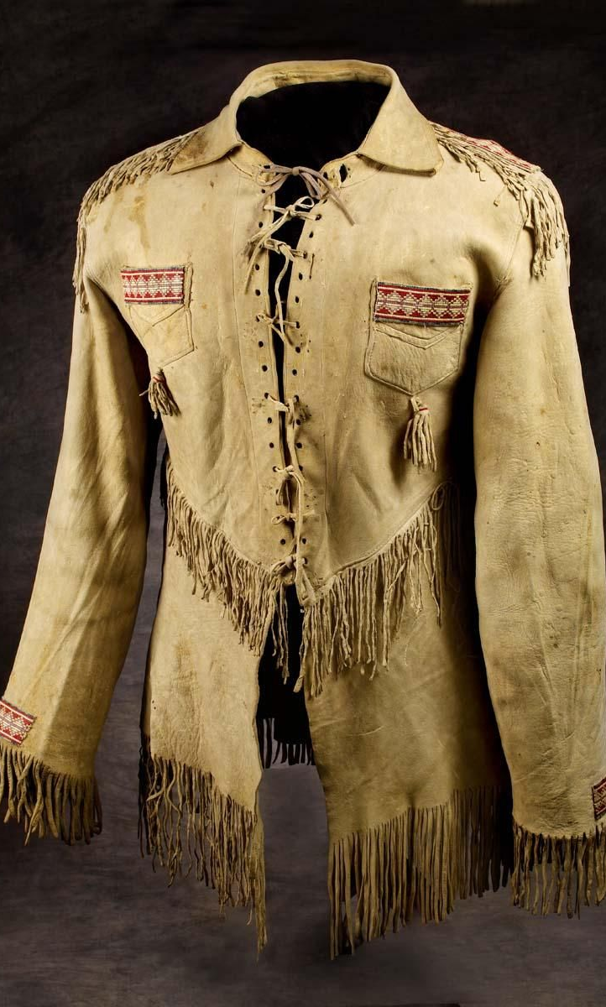
Clothes
The Cree made their clothes from animal hides such as buffalo, moose, or elk. The men wore long shirts, leggings, and Pants.
The women wore long dresses. During the cold winters both men and women would wear long robes to keep warm.

Slide 8
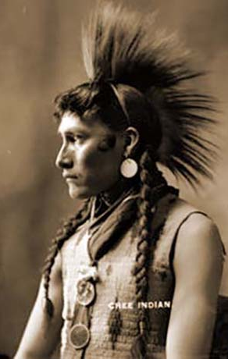
History
In myth
Their ancestor came from the cloud
They asked the great spirit to put themselves down
They fell to the earth by a boat made from the cloud

Slide 9
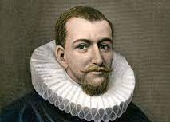
History
The first appearance is from 17th century in the record on the Europe side
Henry Hudson searched around James Bay and Hudson Bay.
Started the trade of a fur
They worked as a trapper

Slide 10
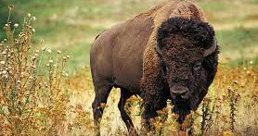
History
They formed an alliance with Assiniboine and Saulteaux for the army and politic.
Along with the growth of their society, their habit moved to the west side.
The fights at that time were to usurp the plains resources such as horses, bison, and territories.
As the result, they required the government to support

Slide 11
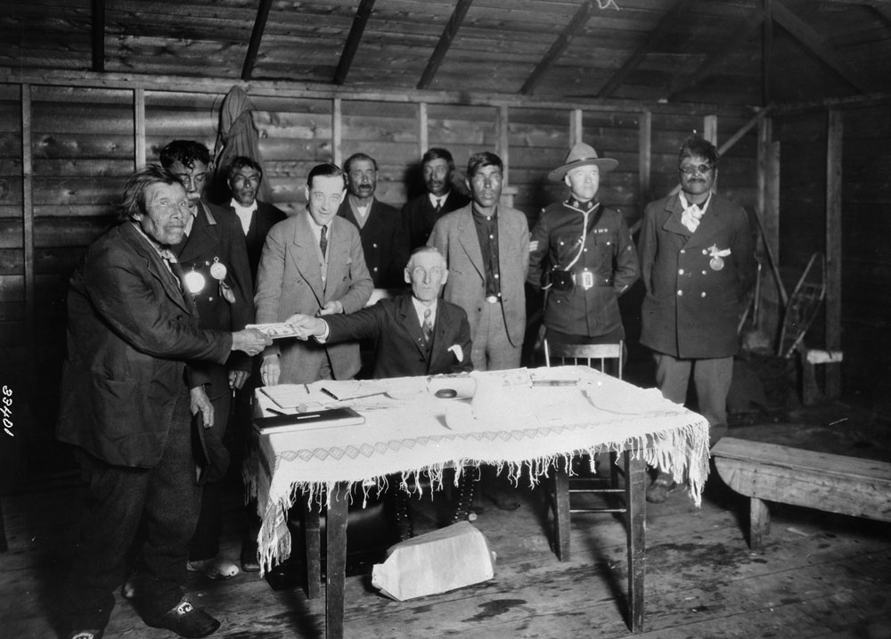
History
They had to take Numbered Indian Treaty with government finally.
However, the perspective for numbered Indian treaty of each side was different.
Some of them joined the fight.
They lost and are kept watch by the government. Children are forced to go to the special school

Slide 12
Present
The number of Cree decreased
They commit to defending the rights of indigenous minorities around the world and preserving the environment on their lands and indigenous traditional cultures, as the greatest first nation in Canada.

